Slide 1



thynk unlimited
Fitness Workout Recommendation Agent
This presentation will introduce our Artificial Intelligence project, highlighting its objectives, methodologies, and potential impact.

Slide 2



02
thynk unlimited
Project goal
A fitness recommendation agent that aims to suggest optimal workout routines based on a user's starting workout and experience level.

Slide 3



thynk unlimited
Problem Statement
In today's fitness-oriented world, individuals often face challenges in designing effective workout routines that are tailored to their experience level, maximize calorie burn, and maintain variety. While there are many generic workout plans available, they are not personalized to individual preferences and goals.
03

Slide 4




04
thynk unlimited
Methodology
Data Collection and processing
Search algorithm
Machine Learning Method
Gather relevant data from sources Clean, normalize, and engineer data.
find optimal path for agent to follow
Choose and train ML algorithms on data to perform prediction and increase performance
www.reallygreatsite.com

Slide 5


05
thynk unlimited
Data Collection and Preprocessing
We gather relevant datasets from various sources and clean, normalize, and preprocess the data to ensure its quality and consistency. This step is crucial for training accurate and reliable AI models.

Slide 6



06
thynk unlimited
Search algorithm
The A* search algorithm:
popular pathfinding algorithm used to find the most optimal solution based on a given heuristic.
www.reallygreatsite.com

Slide 7
thynk unlimited
How A* work
The agent uses A* to find an optimal sequence of workouts based on:
Starting workout type (e.g., Strength, Cardio).
Experience level (e.g., Beginner, Intermediate, Advanced).
A heuristic based on maximizing the calories burned during each workout.
The A* algorithm finds a workout path that maximizes calorie burn, given the constraints of the user's experience level and workout type transitions.
07

Slide 8



9
thynk unlimited
Machine Learning Method
Random Forest Regressor:
A Random Forest Regressor is an ensemble learning model that combines multiple decision trees to make predictions. Each tree is trained on a random subset of the data, which helps improve prediction accuracy and reduce overfitting.
www.reallygreatsite.com

Slide 9
10
thynk unlimited
How ML wok
The model predicts the number of calories burned for each workout based on several features:
Workout type (Strength, Cardio, HIIT, Yoga).
Other features like Max_BPM, Gender, etc.
Training Process:
The model is trained using historical workout data, where the target variable is Calories_Burned.
It is evaluated using the Mean Absolute Error (MAE) to assess the prediction accuracy.

Slide 10
thynk unlimited
08
Agent Type: Goal-Based Agent
Why Goal-Based Agent?
Purpose of the Agent:
Recommends an optimal workout path based on user preferences (e.g., starting workout and experience level).
Maximizes calorie burn, aligning with fitness objectives.
Key Features in the Code:
A Algorithm*: Identifies effective workout sequences using a heuristic to prioritize high-calorie activities.
Prediction Model: Random Forest Regressor estimates calories burned for each recommendation.
Adaptability: Adjusts recommendations dynamically based on user input and constraints.

Slide 11

thynk unlimited
11
How the Agent Works
Goal Definition: Suggest workouts that optimize calorie burn.
Action Planning:
Applies A* to find the best workout sequence.
Evaluates potential paths using a heuristic.
Feedback and Prediction:
Predicts calorie burn for each workout with machine learning.
Visualization: Graphically displays the workout path and estimated calories burned.

Slide 12



thynk unlimited
Result and Impact
A Algorithm Performance*:
The A* algorithm successfully generates an optimal sequence of workouts by considering experience level and maximizing calorie burn. It provides a path that evolves with each workout type, aiming for better results.
12
www.reallygreatsite.com

Slide 13
thynk unlimited
Result and Impact
Calorie Prediction Model Performance:
The Random Forest Regressor predicts calories burned with a reasonable level of accuracy. The Mean Absolute Error (MAE) metric was used to evaluate model performance, with results showing good predictive accuracy on the test set.
13
www.reallygreatsite.com

Slide 14
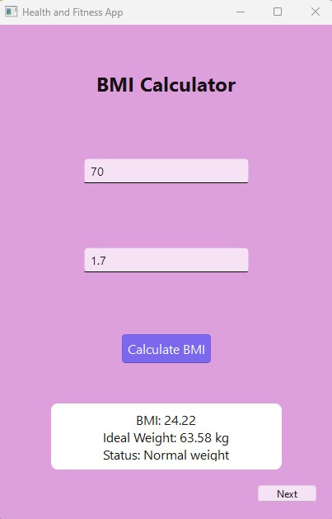

14
thynk unlimited
GUI
we made small gui to visualize some information and some health tipc and prediction for calories burned depend on data of user.
Window 1: BMI Calculator
Output:
A calculated BMI value (e.g., 22.5) is displayed along with the corresponding ideal weight and status (e.g., "Normal weight").
If invalid input is provided (e.g., negative values or non-numeric input), an error message is shown via a popup dialog.

Slide 15


15
thynk unlimited
GUI
Window 2: Health Tips
Output:
Based on the BMI status determined in Window 1, the app shows customized health tips (e.g., diet and exercise recommendations).
If no valid weight or height is provided, the app will display an error message prompting the user to enter valid values.

Slide 16
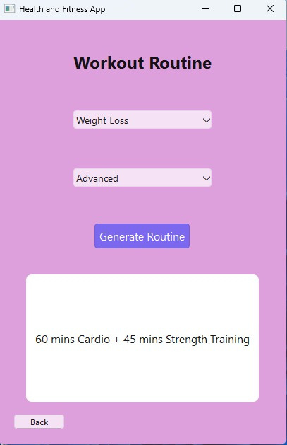

16
thynk unlimited
GUI
Window 3: Workout Routine
Output:
After selecting a fitness goal (e.g., "Weight Loss") and an experience level (e.g., "Beginner"), the app generates a tailored workout routine (e.g., "30 mins Cardio + 20 mins Bodyweight Exercises").
The workout details are displayed in a larger, readable label.

Slide 17


thynk unlimited
Future Directions
Refining the Search Algorithm:
The A* algorithm could be enhanced by considering additional constraints, such as workout duration, time availability, and injury history.
Advanced Calorie Prediction Models:
We could explore more sophisticated machine learning models (e.g., Gradient Boosting or Neural Networks) to improve the accuracy of calorie predictions.
Real-Time Data Integration:
Future work could involve integrating real-time data from fitness trackers to make the recommendations adaptive to a user's current performance (e.g., heart rate, calories burned in real-time).

Slide 18




thynk unlimited
Thank You!

